Slide 1
Plasma from Mice with A549 cell line

Slide 2
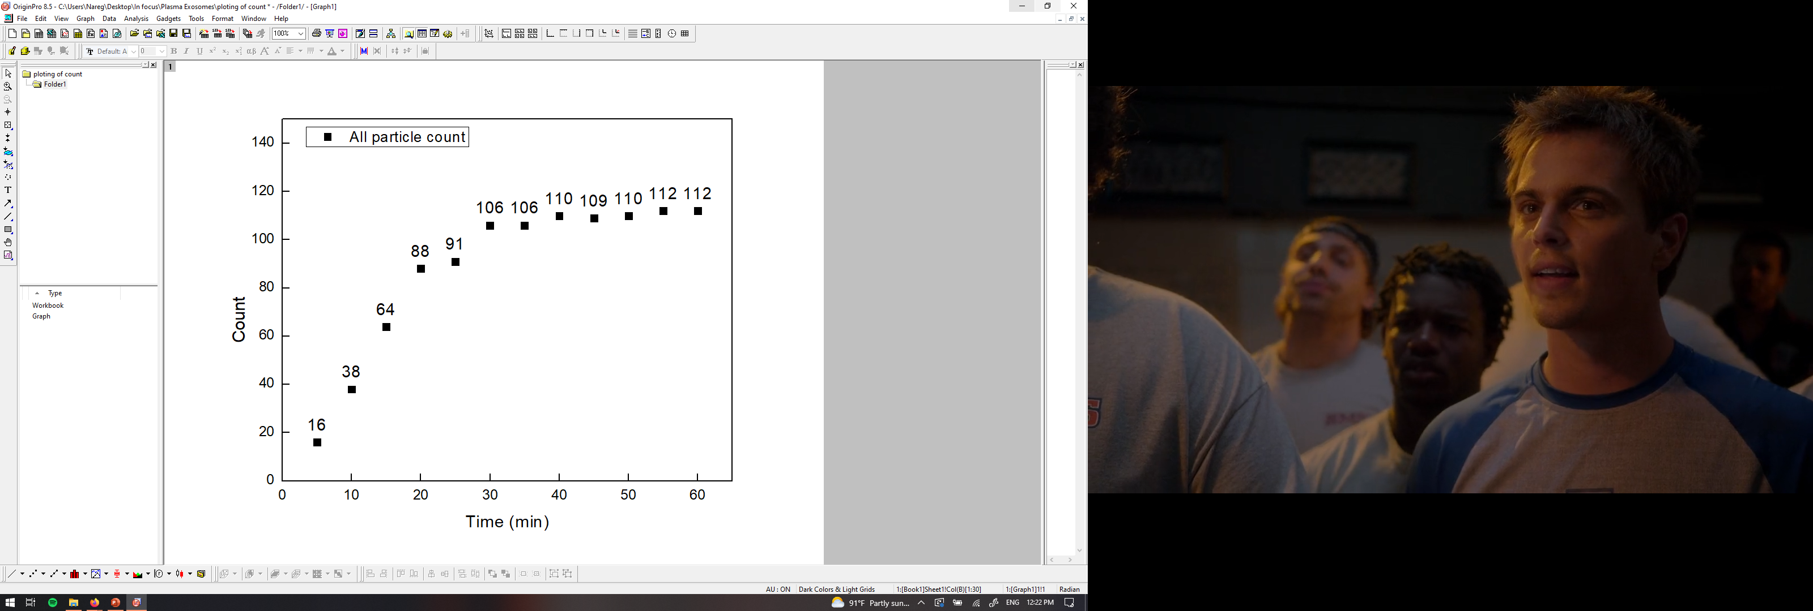
PANORAMA of mouse 276 (5-11-2022)
Time: 60 min
Count: 112 (Ex: 55; Large: 57)
Time: 60 min wash
Count: 6
Note: 0 % response to miRNA-21
Scale bar: 10 µm

Slide 3
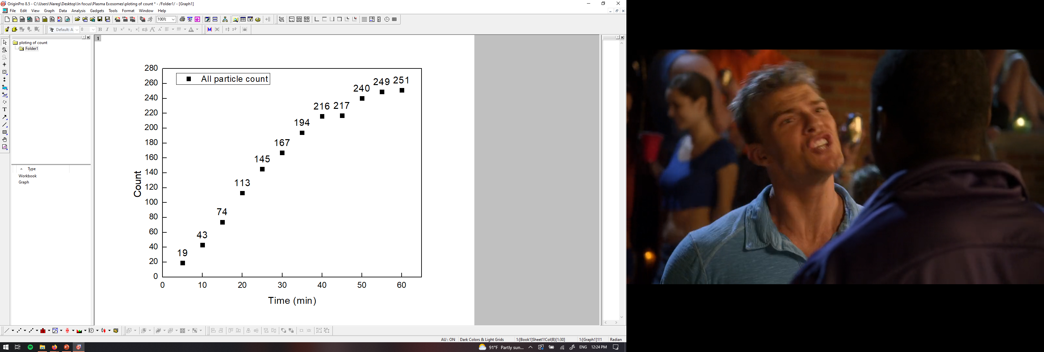
PANORAMA of mouse 276 (5-19-2022)
Time: 60 min
Count: 251 (Ex: 105; Large: 146)
Time: 60 min wash
Count: 6
Note: 0 % response to miRNA-21
Scale bar: 10 µm

Slide 4
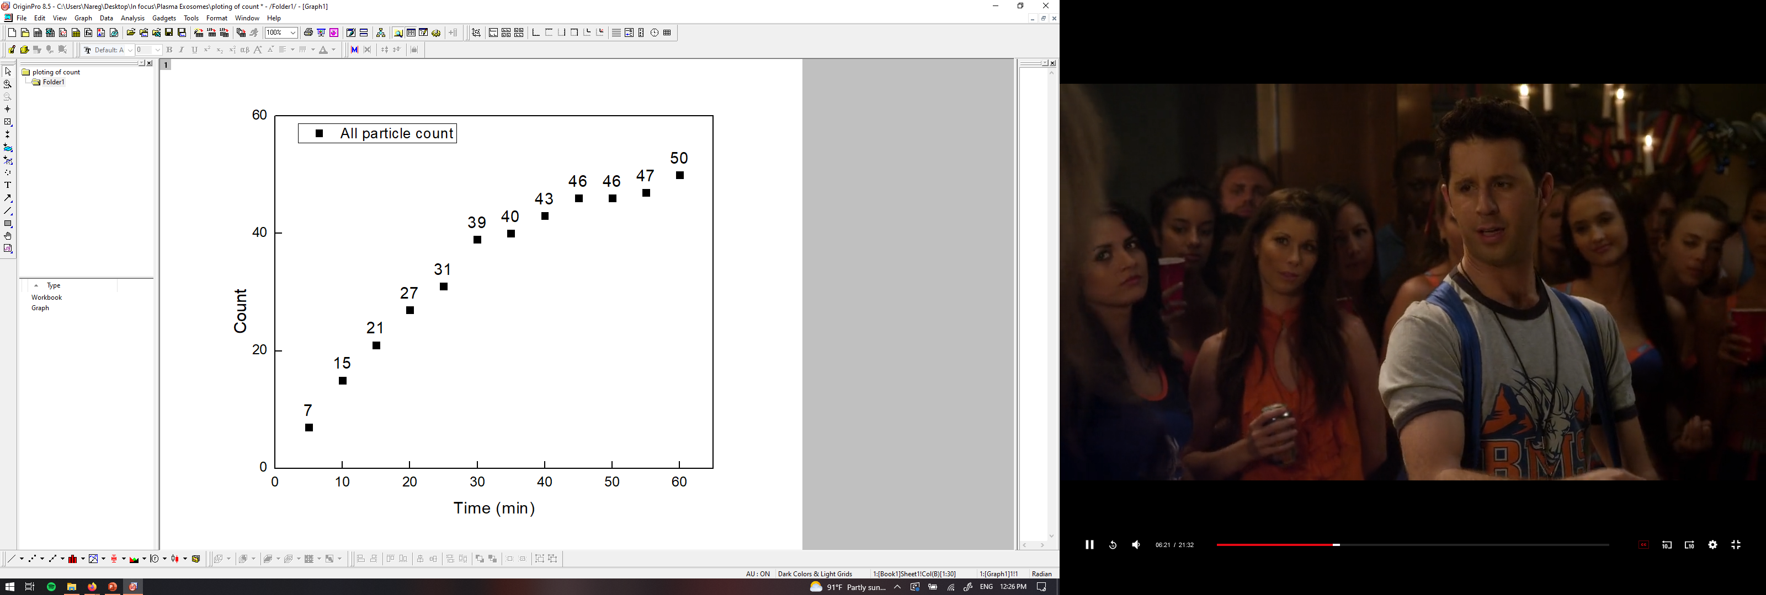
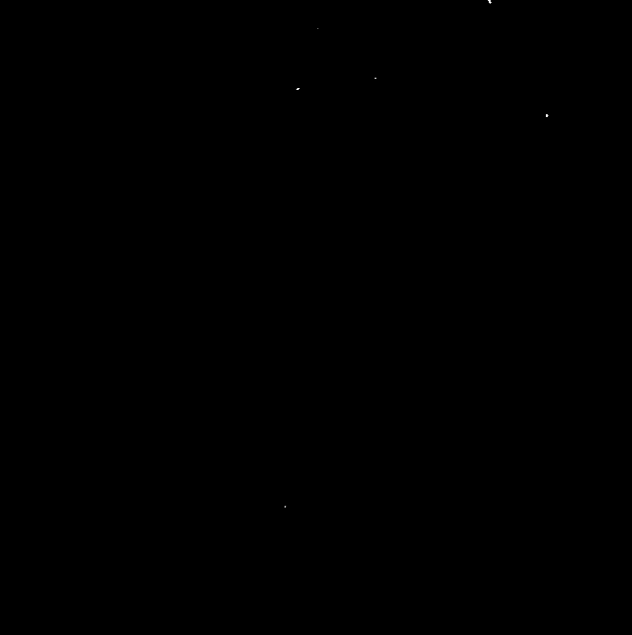
PANORAMA of mouse 276 (5-26-2022)
Time: 60 min
Count: 50 (Ex: 41; Large: 9)
Time: 60 min wash
Count: 5
Note: 0 % response to miRNA-21
Scale bar: 10 µm

Slide 5
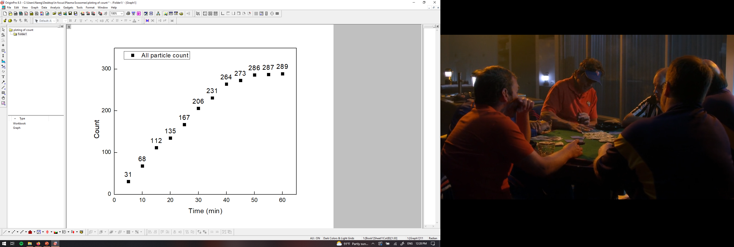
PANORAMA of mouse 276 (6-2-2022)
Time: 60 min
Count: 289 (Ex: 194; Large: 95)
Time: 60 min wash
Count: 9
Note: 0 % response to miRNA-21
Scale bar: 10 µm

Slide 6
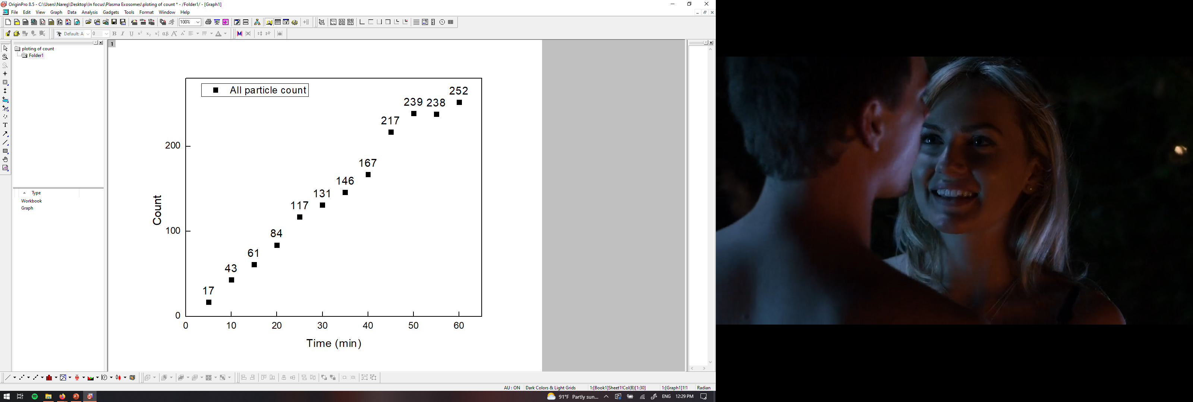

PANORAMA of mouse 276 (6-9-2022)
Time: 60 min
Count: 252 (Ex: 192; Large: 60)
Time: 60 min wash
Count: 9
Note: 0 % response to miRNA-21
Scale bar: 10 µm

Slide 7
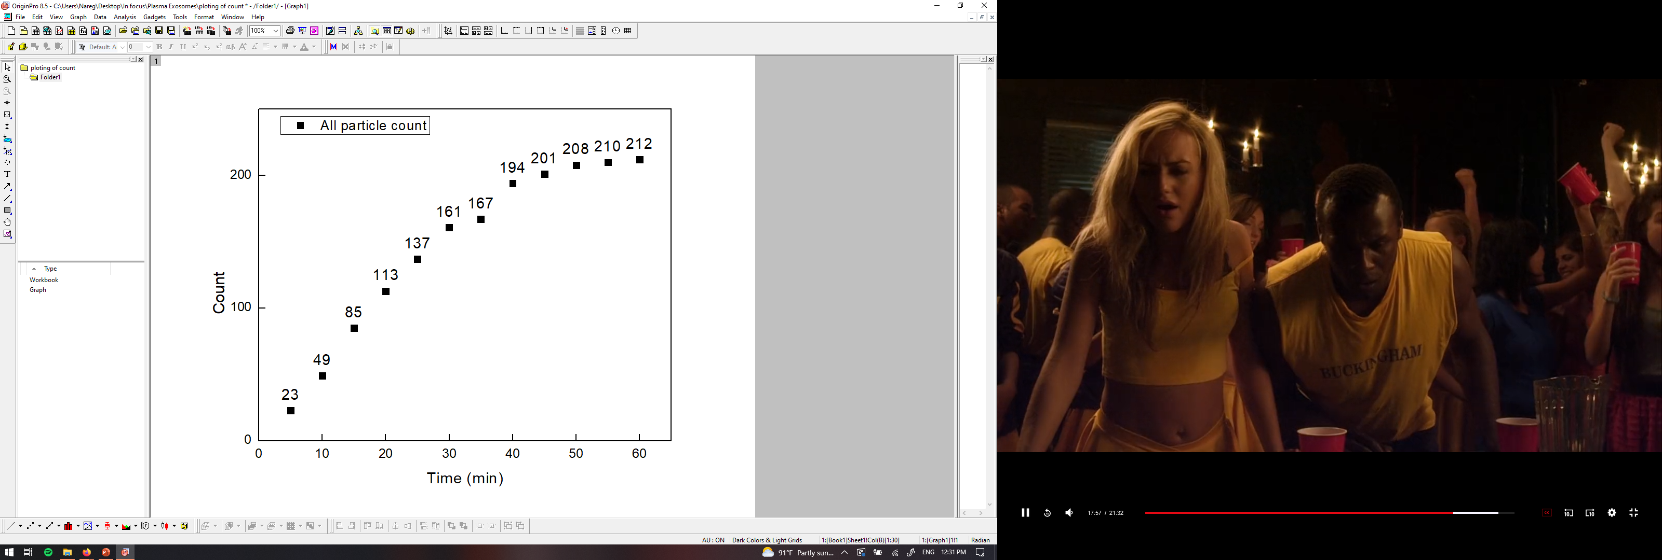
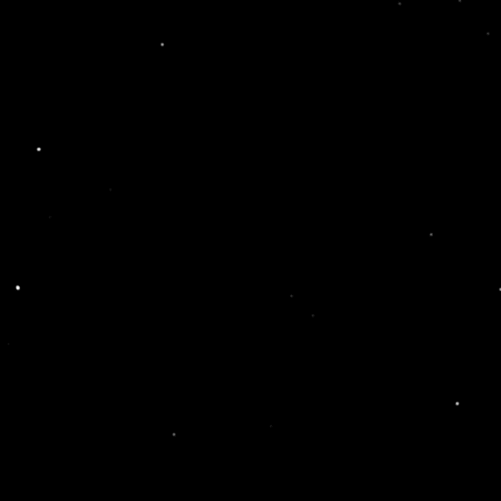
PANORAMA of mouse 276 (6-16-2022)
Time: 60 min
Count: 212 (Ex: 147; Large: 65)
Time: 60 min wash
Count: 14
Note: 0 % response to miRNA-21
Scale bar: 10 µm

Slide 8
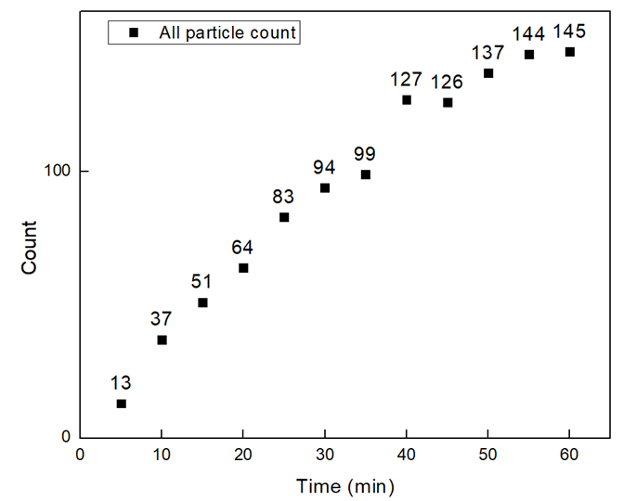

PANORAMA of mouse 276 (6-23-2022)
Time: 60 min
Count: 145 (Ex: 85; Large: 60)
Time: 60 min wash
Count: 14
Note: 0 % response to miRNA-21
Scale bar: 10 µm

Slide 9
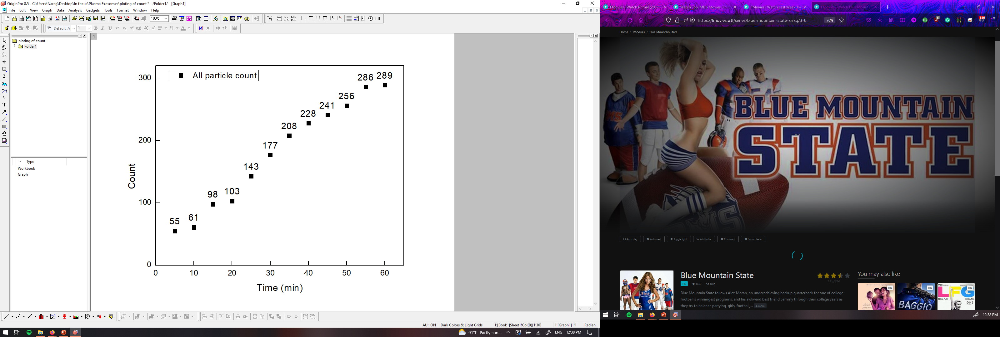
PANORAMA of mouse 276 (7-5-2022)
Time: 60 min
Count: 289 (Ex: 209; Large: 80)
Time: 60 min wash
Count: 28
Note: 0 % response to miRNA-21
Scale bar: 10 µm

Slide 10
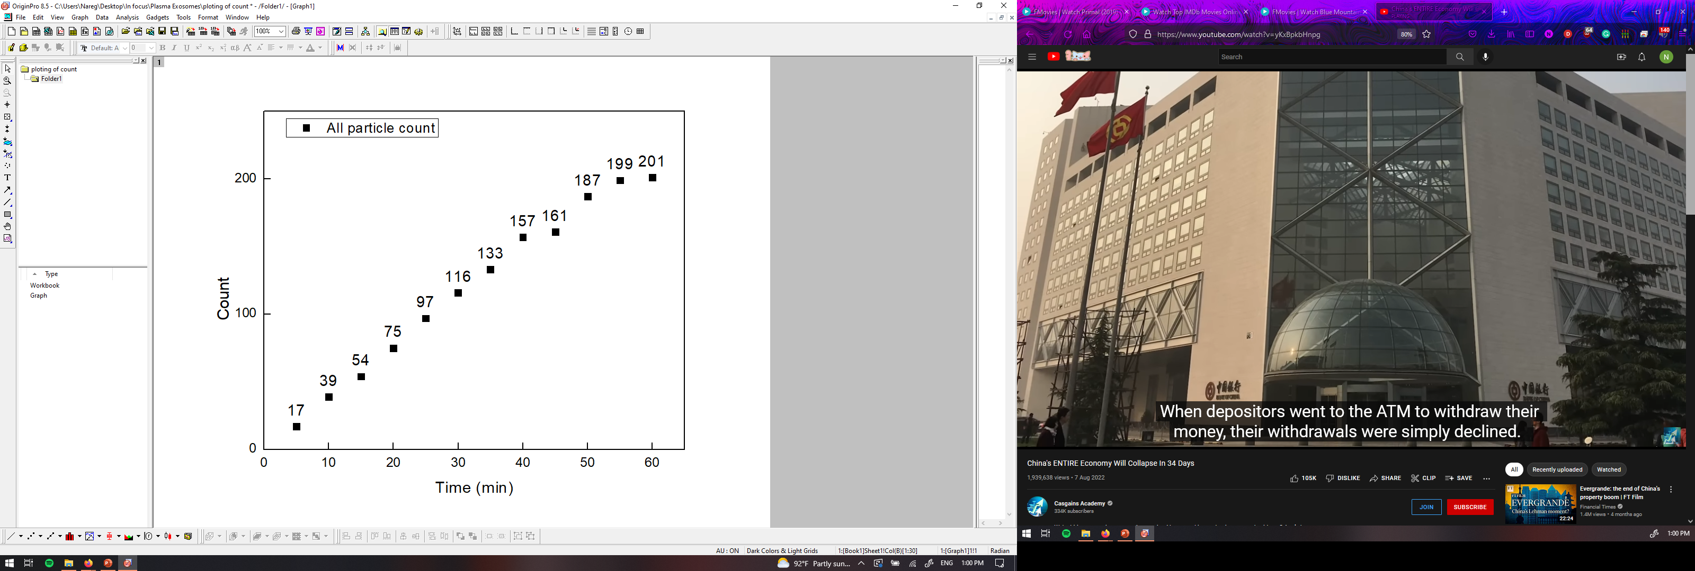
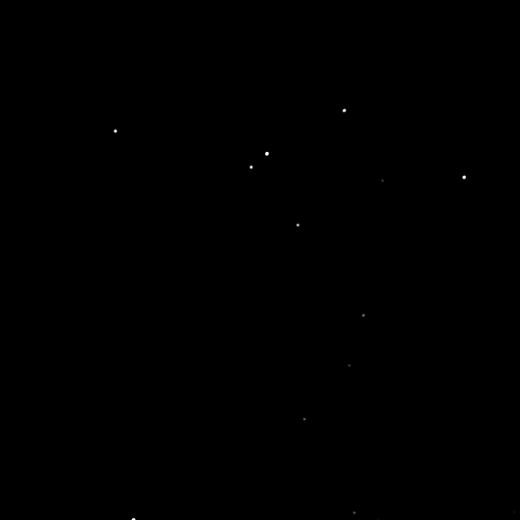
PANORAMA of mouse 276 (7-15-2022)
Time: 60 min
Count: 201 (Ex: 81; Large: 120)
Time: 60 min wash
Count: 10
Note: 0 % response to miRNA-21
Scale bar: 10 µm

Slide 11
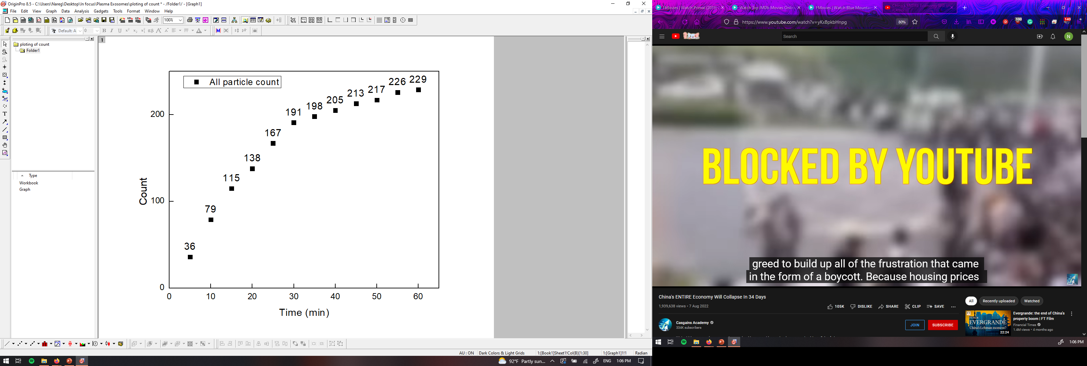

PANORAMA of mouse 276 (7-21-2022)
Time: 60 min
Count: 229 (Ex: 129; Large: 109)
Time: 60 min wash
Count: 17
Note: 0 % response to miRNA-21
Scale bar: 10 µm

Slide 12
Set2

Slide 13
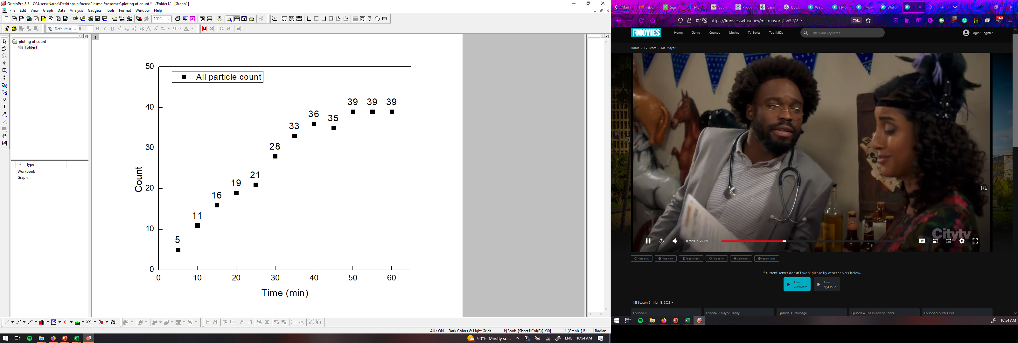
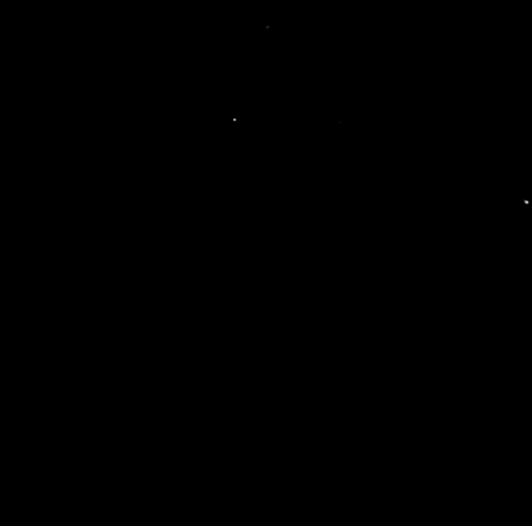
PANORAMA of mouse 277 (5-11-2022)
Time: 60 min
Count: 39 (Ex: 37; Large: 2)
Time: 60 min wash
Count: 3
Note: 0 % response to miRNA-21
Scale bar: 10 µm

Slide 14
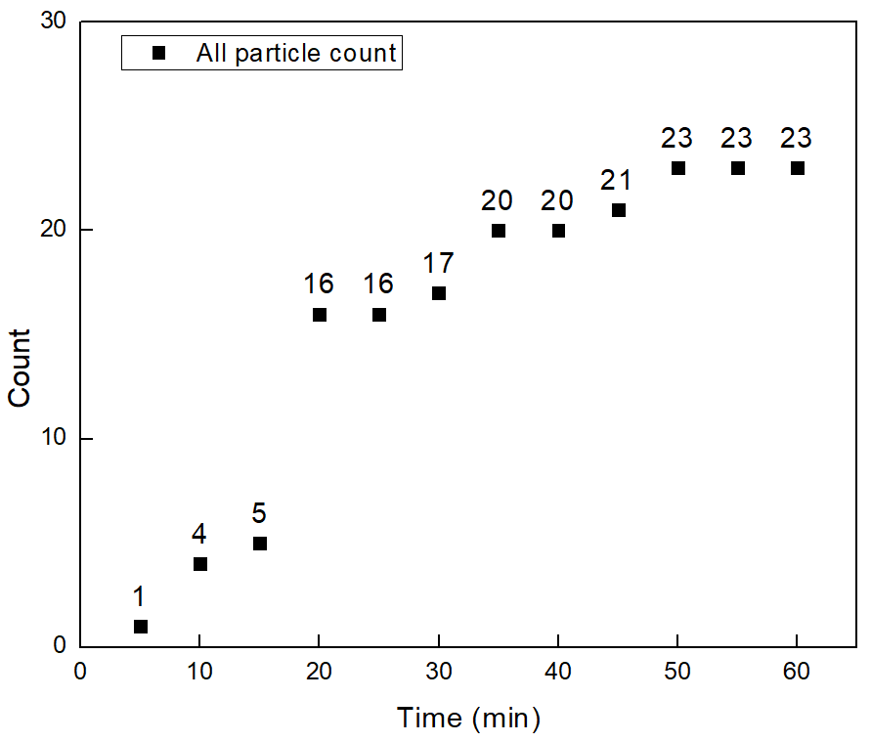
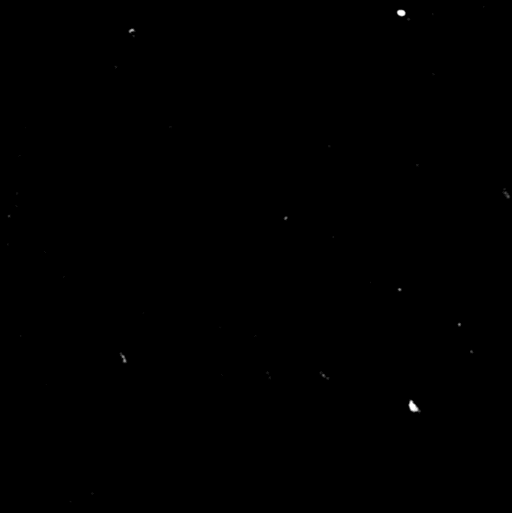

PANORAMA of mouse 277 (5-19-2022)
Time: 60 min
Count: 23 (Ex: 19; Large: 4)
Time: 60 min wash
Count: 3
Note: 0 % response to miRNA-21
Scale bar: 10 µm

Slide 15
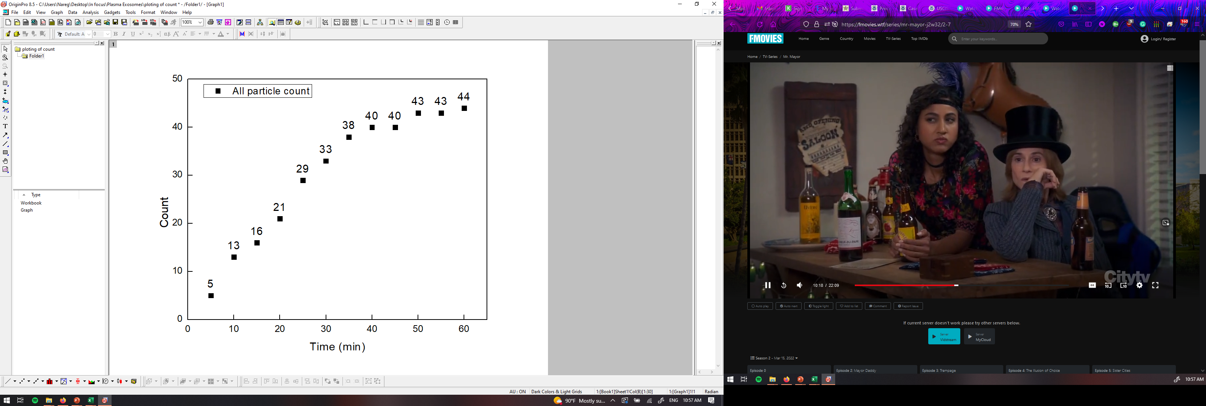

PANORAMA of mouse 277 (5-26-2022)
Time: 60 min
Count: 44 (Ex: 44; Large: 0)
Time: 60 min wash
Count: 1
Note: 0 % response to miRNA-21
Scale bar: 10 µm

